Slide 1


Slide 2


RESUME SKILLS
Notes:
Reference - https://www.myperfectresume.com/career-center/resumes/how-to/perfect-work-history
https://novoresume.com/career-blog/how-to-write-a-resume-guide

Slide 3

RESUME SKILLS
Let’s start from the basics..
What is a resume?

Slide 4

RESUME SKILLS
Structure of a standard resume

Slide 5
RESUME SKILLS
How resume template helps ?
Organize Your Resume
No Experience Needed
Make a Great First Impression
Save Time
Notes:
Read on for some of the most interesting benefits you should consider when deciding whether to use a resume template.
1. Organize Your Resume : It is very important that your resume is organized and filled out appropriately. A well-organized resume looks more professional than one that is not organized. Using a resume template helps you organize your thoughts and ensures that everything is filled in its appropriate place. It helps you remember important details that should be on your resume, making sure that nothing important is left out.
2. No Experience Needed : You don’t need any experience to create your resume using a resume template. Templates are always very easy to fill out and if you are not satisfied with the arrangement, you can modify it to best suit your individual needs as the job-seeker. A lot of people don’t have a clue about how to start typing or building a resume from scratch. If you’re anything like me and you are one of those people, you can keep things simple by using a resume template and be assured that you have correctly filled in every critical detail you require for the job application.
3. Make a Great First Impression : Your resume is the first understanding and impression that an employer gets of you.2 It sets out your skills, talent level(s), experience, and all the other information an employer would need to know in order to understand your potential as a candidate for the job in question. If your resume is not properly written or constructed, you might not even be considered or given a chance to prove yourself. Using a creative resume template would help you adequately showcase your skills and talents to an employer.
4. Save Time : Designing and building your own resume from scratch can be time-consuming and after spending lots of time and energy on it, you might not end up with a good result, especially if you are not familiar with great resume building. Using creative resume templates would be a good way to save your time and show your potential employers that you have the necessary skills for the job. Using resume templates is also a time-saving advantage if you are applying for more than one job. Creating different types of resumes for the jobs you are applying for could take a lot of time because not every job requires the same resume format because you might need different skills for different jobs and clients. With a resume template, you can easily modify the template and create several versions of your resume that suit other job industry standards if you are applying for several jobs at the same time. That way you would have the appropriate resume format for each desired position or job that you are applying for. From saving time to making a great first impression, there are lots of advantages and benefits of using a template and these are just a few of them. There are also several template building websites and applications that you can use to achieve this.

Slide 6
RESUME SKILLS
Risks with using templates :
Same as everyone else
A lot of the templates out there are substandard
You are selling yourself short
What a job seeker should do
Notes:
• Same as everyone else: Employers have developed a trained eye for spotting resume templates. Recruiters can spot them a mile away. The two benefits of using a resume is that it requires little time and effort to write your document. Basically, it’s the lazy way of doing it.
• A lot of the templates out there are substandard: Templates are highly recommended and are supposedly written by an expert. Whoever these ‘experts’ are shall remain one of mankind’s great mysteries. Unless you are in the career industry, telling which resumes are good, bad and ugly will be very difficult and not advisable.
• You are selling yourself short: Surely you deserve the best resume there is and not just a run-of-the-mill template ripped off from the web? By really taking the time to making your own resume, you will enhance your life skills as you have to master writing sales copy, creating a salesy layout and a format that is pleasing on the eye. It will take time to make a great resume, but the finished product can be used throughout your career (just update it every now and then!).
• What a job seeker should do: Go out and Google resumes in your field, both templates and resumes from actual people who have posted their documents publicly. Save up to 10 decent ones and start reading and getting a feel for the language, layout and formats. Then delete all the saved resumes and start with your own from a blank canvas. It will be full of inspiration from others and instead of copying what they have written, you will now cherry pick their components and putting them on paper with your own words. Writing a resume from scratch is hard work but it’s doable for all of us and one thing is certain: it will get noticed. A human recruiter generally searches for spelling errors, lack of relevant skills in a resume for automatic rejection

Slide 7

RESUME SKILLS
What is the basic structure of a resume?

Slide 8
RESUME SKILLS
Sections in a resume :
Contact Information
Resume Summary
Experience
Certifications
Education
Skills
Notes:
• Contact Information: In the contact information section of your resume, the following details are included:
✓ Your full name
✓ Address (including a permanent address if you have a temporary school address-list both)
✓ Phone number(s) to contact you
✓ Professional-sounding email address (i.e., avoid using something like young_babe@gmail.com)
In addition, you can also include your LinkedIn profile information or a website URL if you have a personal website. Formatting the Contact Information resume section is really a matter of personal preference but stick to the guidelines of basic resume formatting to keep it looking professional.
• Resume Summary: A Summary of Qualifications or Profile resume section is used to draw attention to specific skills or qualifications that are relevant to a position for which you are applying. This section is optional, and its use largely depends on the field you are entering. In scientific fields, for example, highlighting your skills at the top of your resume is a good idea. Make sure to tailor the information you include to the position for which you are applying.

Slide 9

RESUME SKILLS
Resume format importance
Notes:
The format of your resume is just as important as the information you put in it. Resume formats can determine the way a recruiter or hiring manager perceives you, and more importantly how the ATS parses each section included in your resume. Your resume format is the first quick impression of you both personally and professionally.
Formats are also important in capturing the recruiter or hiring manager’s attention. They most likely only have time to skim your resume, so your goal is to put the most important information about yourself in places that are easily seen (aka at the top). Don’t hide accomplishments and relevant experience too deep within your resume.
Different resume formats highlight different aspects of your professional skills and accomplishments. Once you get an interview, you can go into more detail about yourself, but your resume should showcase the very best things. So, choosing the correct format, based on your professional history, can make a big impact on recruiters very quickly.

Slide 10

RESUME SKILLS
TIPS FOR BETTER RESUME
Notes:
Resume templates are a quick and easy way to start on your resume. A template includes the basic format of a resume. All you have to do is simply edit the document to include your personal information. Using a template can reduce the amount of time you have to spend formatting, allowing you to focus on ensuring that the content of your resume shines.
NOTE: “ATS stands for Applicant Tracking Systems” An ATS is a type of software application that handles the recruitment process, namely sorting through thousands of resumes, to determine which ones are the best fit for the positions for which they were submitted. Applicant tracking systems do not process your resume so differently from recruiters glancing at your resume, as both are looking for certain criteria for inclusion. Whereas human recruiters are often looking for grounds for automatic rejection, such as spelling errors or lack of relevant skills, applicant tracking systems operate by searching resumes for keywords. Few reasons for the usage of ATS by recruiters are to keep a track of candidates, to keep tabs on the list of resumes obtained, and to avoid accidents like missing resumes or deleting mails with resume The ATS rank the resume of a candidate by checking If more number of keywords matches rank increases Now that you are clear about the structure of resumes let’s focus on formatting to get the best resume done.

Slide 11
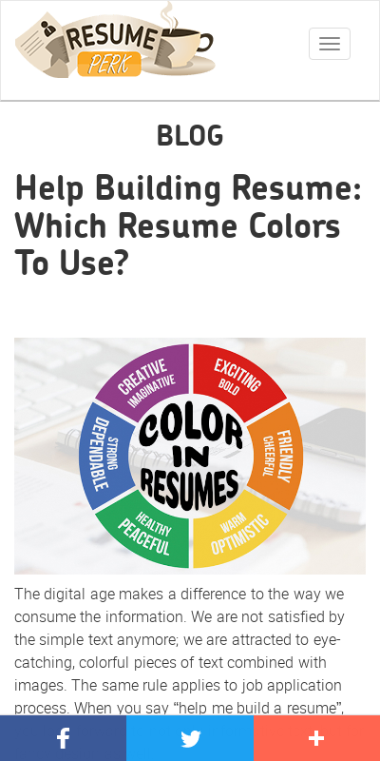
RESUME SKILLS
Formatting - Use of color and font

Slide 12
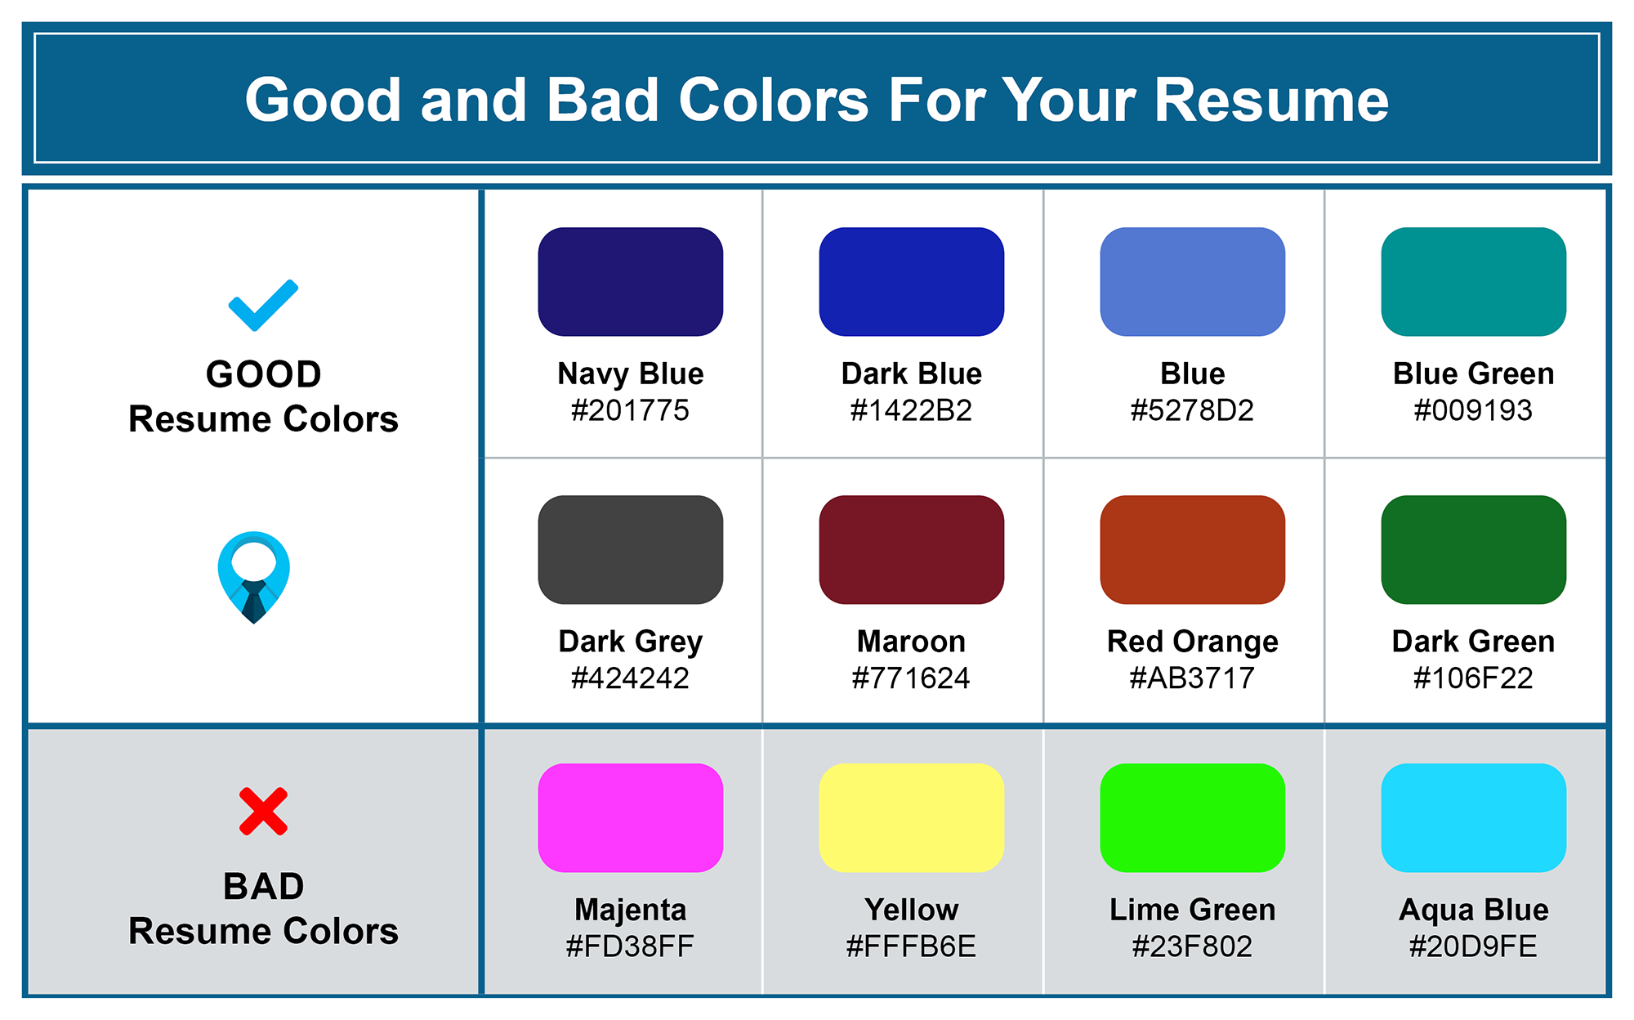
RESUME SKILLS

Slide 13
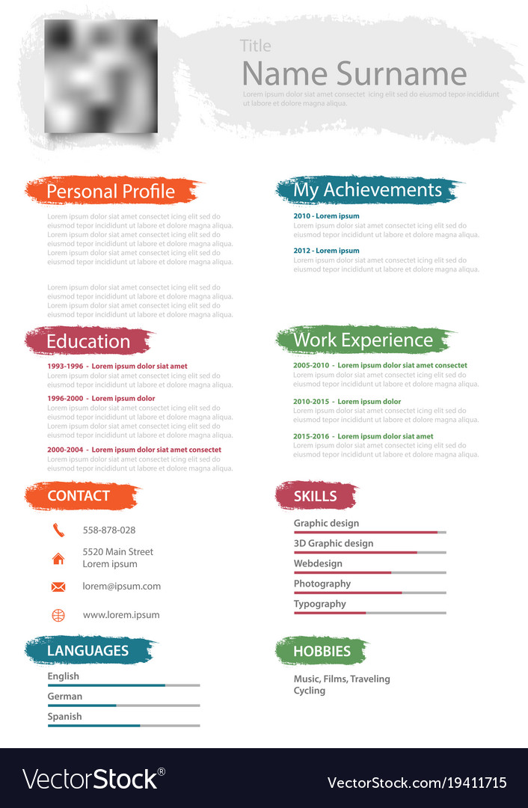
RESUME SKILLS
Example

Slide 14
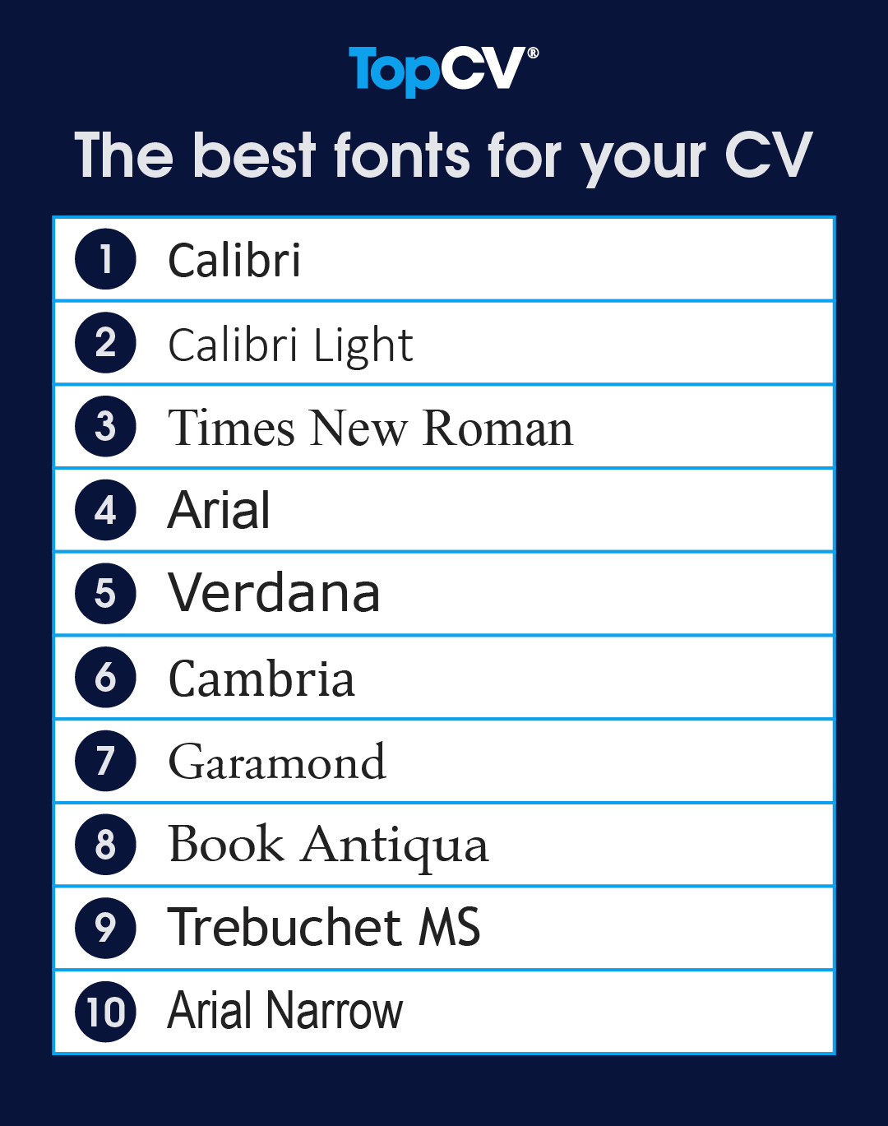
RESUME SKILLS
Use of font :
Serif
Times New Roman
Garamond
Georgia
Sans-serif
Arial
Calibri
Verdana

Slide 15
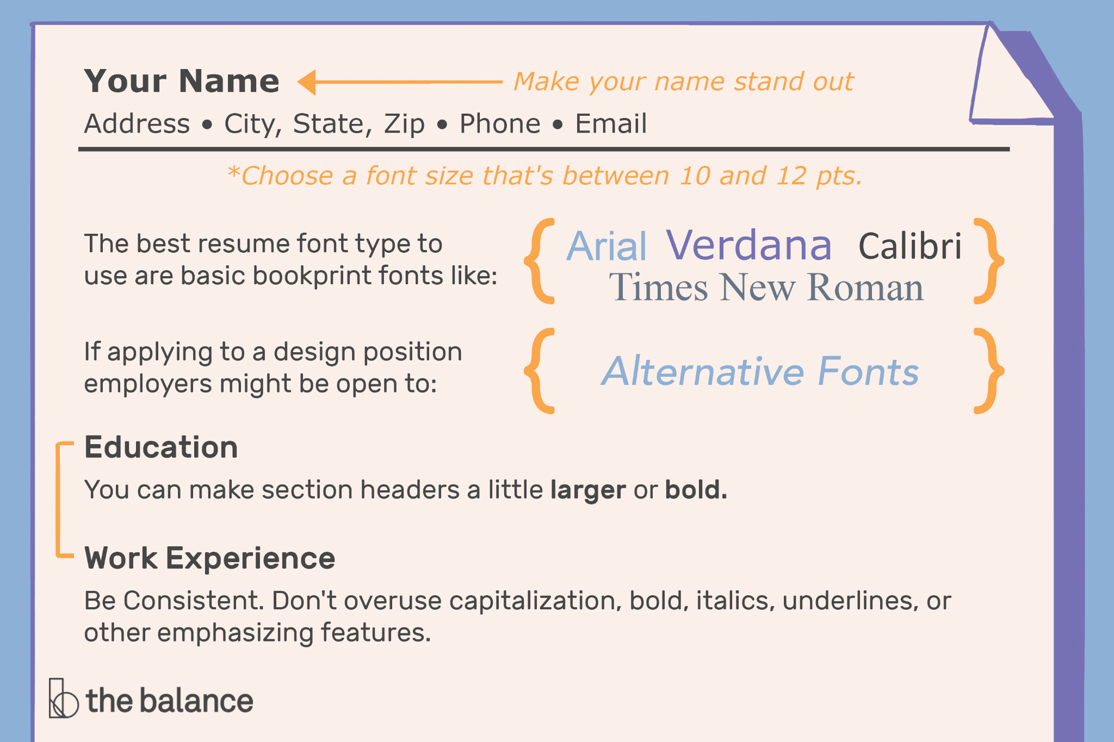
RESUME SKILLS

Slide 16

RESUME SKILLS

Slide 17

RESUME SKILLS
Introduction to Power verbs and Write up

Slide 18

RESUME SKILLS
What are Power verbs?
Notes:
Power verbs are action words that have positive meanings in English. When you use a power verb, you can communicate your message more strongly and confidently than when using other verbs. Developed is a power verb. You sound more confident and interesting using 'developed'

Slide 19

RESUME SKILLS
Benefits of Power verbs
Notes:
The power words or the action verb in your resume adds quality to your resume. It will help you to get short listed in electronic short-listing process. The power words express your past job responsibilities that you handled during your previous employments. The action words illustrate to the employers your transferable skills that you acquired to fit the job requirements. Today action verbs and keywords are extremely necessary in your resume. Knowing the different keywords for any industry and writing them in your resume will benefit you a lot. It is important to plant the power words and keywords in your resume strategically, so that they match the job requirements and easily get picked up.

Slide 20
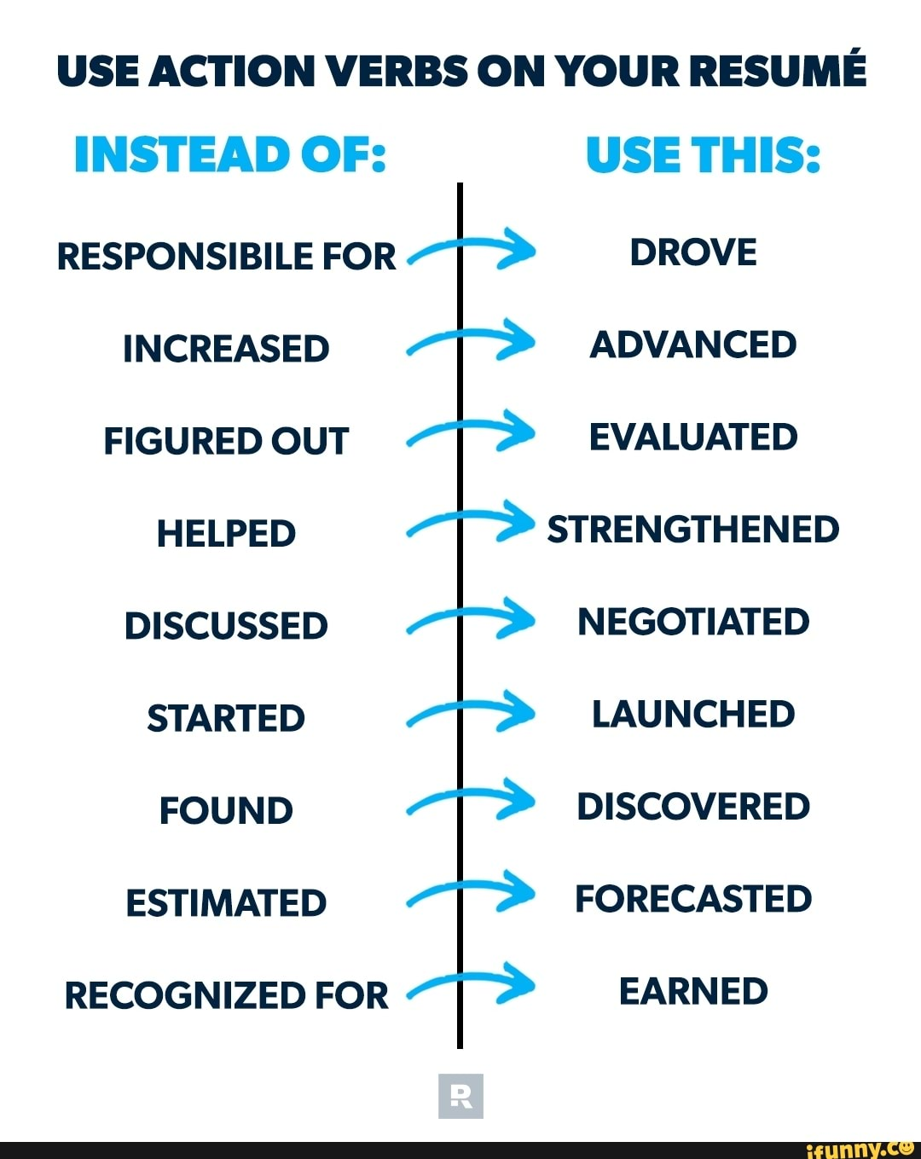
RESUME SKILLS

Slide 21







/ethnuscodemithra
Ethnus Codemithra
/ethnus
/code_mithra
THANK YOU
https://learn.codemithra.com/
codemithra@ethnus.com
+91 7815 095 095
+91 9019 921 340

